Slide 1
INVISIBLE FENCE BRAND ACADEMY
2018

Slide 2
Dog Bite Prevention

Slide 3
Statistics
4.5 million people are bitten a year
1 in 5 bites need medical attention
Children are most common victims
Notes:
******General Statistics******
Purpose for you is to be safe
have some basic knowledge to help our clients for potential risks and when to seek help

Slide 4
5 Main Reasons
Possessiveness
protecting property (toys, food, territory or human)
Fear
strangers or unfamiliar situations
startled dog (sleeping or catching off guard)
3. Medical
chronic injury, hip dysplasia or other unknown conditions
4. Maternal instinct
5. Prey Drive
running, cycling, fast movements

Slide 5
Warning Signs
Ears
Pinned back
Eyes
Half moon, seeing whites of the eyes, intense eye contact, furrowed brow
Body
Stiff ridged posture, fur along back may stand up, head pulled back
Mouth
Lip curled up, showing teeth, yawning
Tail
waging, stiff
Notes:
Wiggley dog vs. Stiff dog! Curves vs. Angles

Slide 7
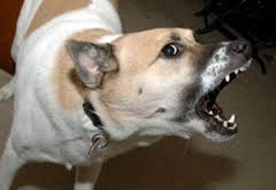
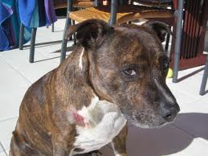
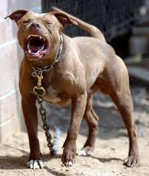
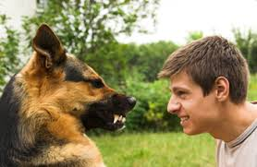

Slide 8
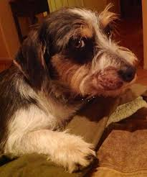
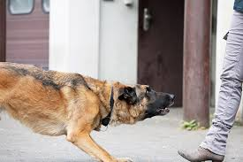
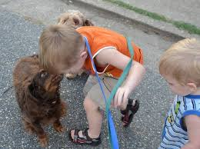
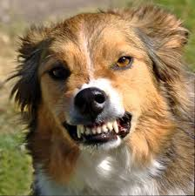

Slide 9
You can prevent dog bites

Slide 10
Define Behavior
Fear and Anxiety
Aggressive vs Aggressive Display
Arousal Levels (dog fight, food, tie out)
Notes:
Bark collars for fearful or dogs with anxiety
Re-Roofing a home

Slide 12
Remember you look “Sneaky”
For many dogs having a stranger creep around the perimeter is unnerving.
If a dog is on a tie out or Kennel watching you and getting revved up- see if the dog can be moved into the house or garage where he can’t see you
Avoid greetings at the threshold. These are very exciting and increase the likelihood of a bite. Have the owner bring the dog outside.

Slide 13
Risky Behavior
What puts us most at risk for a bite?
Walking into homes
Putting collars on
When dog feels containment correction
Walking away

Slide 14
Is the customer concerned?
Have the owner put dog up when entering the house if you have a concern or if the owner is concerned about you meeting the dog.
Have the owner bring the dog out on leash after you have been seated (kitchen table or similar, so your not “Low”)
Avoid wearing hats and sunglasses
Have high value treats you can throw on the ground in your pocket
Many dogs that are pushy aggressive are cheap for treats

Slide 15
Protect
Stay Calm
Resist the impulse to scream and run away.
Remain motionless
arms crossed on your chest, and avoid eye contact with the dog.
Stand slightly sideways (narrower target)
Do not get down at dog level unless you are very sure the dog is friendly.
Once the dog loses interest in you, slowly back away until he is out of sight.

Slide 16
Protect
Claim your space
Use an object to keep the dog back (programmer, flags, shovel)
Protect face, chest, throat and make a fist
If bite occurs resist urge to pull away

Slide 17
Bite in the Field?
Have owner secure dog
Call your manager
File incident report

Slide 18
Owner Prevention
Socialize – This is the number one way to prevent aggressive behavior
Train them well- a good recall and leave it command go a long way to avoiding aggressive behavior
Spay/ Neuter- ????? (Female German Shepard)
Exercise and Play
Avoid aggressive games
Don’t let them roam free
Vaccinations
Notes:
Spay/Neuter….. Americans have highest number of dog bites and also highest number of multiple dog homes and highest spay and neuter.
*****Second dog
Dog for your dog without training that new dog can be a problem

Slide 19
Questions?

